Slide 1
Transitioning into Middle School

Slide 2
What’s Different?

Slide 3
Movin’ On Up
New school, new location, or maybe the same school
New people
New school subjects
New teachers
It’s a chance for adventure and to start with a clean slate.

Slide 4
The Student Body
Moving from the oldest kid to the youngest
These kids were young once – they will help you.
If you ever feel bullied, just tell a teacher or counselor.
Try to keep yourself open to all kinds of friends.

Slide 5
More Work!
More Challenging
Papers and Exams in addition to Homework
More responsibility
Different grading scale

Slide 6
New Rules
Attendance
Dress Code
Disciplinary procedures
Other administrative policies

Slide 7
Class Schedule
Keep a copy of schedule in your notebook
Ask for help if needed
Different classes on different days
Different room every hour

Slide 8
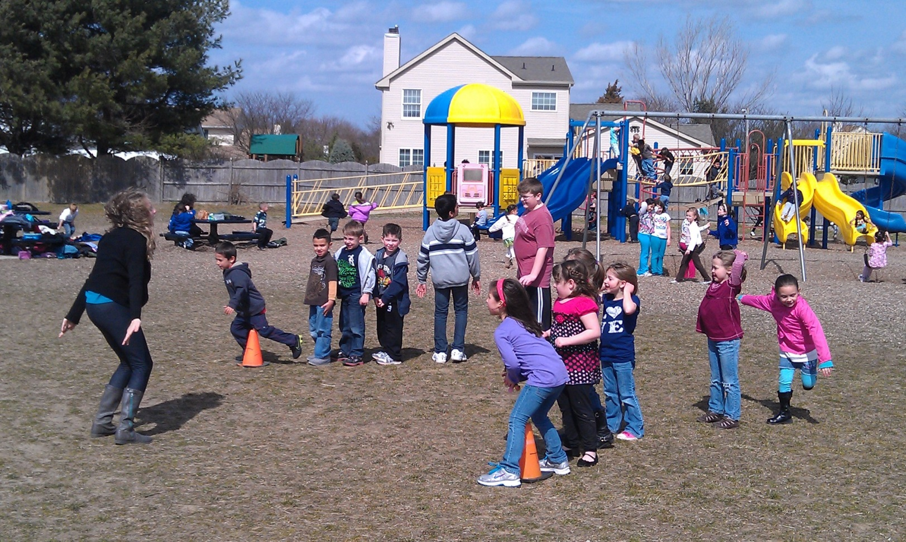
Bye-Bye Recess
You will survive without it!

Slide 9
You’ll be a PRO in no time
Have the right attitude
Get solid information on what to expect
Get the supply list early
Attend orientation or open house
Read the school handbook

Slide 10
Tips on Making the Transition
Don’t overload with too many accelerated classes
Make a good first impression
Walk on the right side of the hallway
Study in Advance
Avoid procrastination

Slide 11
Top 5 Survival Tips
Stay organized and be on time to class
Do your homework and know when assignments are due
Try new things
Make plans to sit with your friends at lunch
Know your locker combination and keep space organized

Slide 12
Acing Academics
Come to school everyday
Have your supplies ready
Follow directions
Participate in class
Pay attention in class
Talk to your teachers
Take notes
Don’t procrastinate
Ask questions
Study as much as you can
Don’t stress over your grades
Stay healthy

Slide 13
Develop Study Skills
Know the purpose of each assignment
Review, review, review
Plan a time and place for studying each day
Study for a while and take short breaks
Don’t cram for hours the night before a test
Study a little bit each day
Think positive…Do your best!!

Slide 14
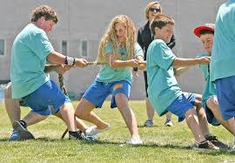
Get Involved!
Sports
Clubs
Activities
Explore new interests
Make new friends
Have lots of fun!
Watch for times/days for school team tryouts. If you make the team, you will probably have summer camps and practice.

Slide 15
Making Friends
Positive people make you a better person
Helps in making good choices
Going to the right places
Doing the right things
Be a leader, not a follower
Make yourself a better person by surrounding yourself with good friends!!!

Slide 16
Making Friends
Find people you know
Find people that live near you
Be open to new friends
Be yourself
Talk to people
Be nice!!

Slide 17
How to keep peace with friends?
Always tell the truth
Never spread rumors
Only say things that build people up
Trust others
Always apologize

Slide 18
Avoiding Trouble
Know and obey school’s rules
Avoid drama, rumors and gossip
Don’t let your friends get YOU in trouble
Learn how to solve problems
-ask for help when you need it
-apologize and accept consequences when you’ve done something wrong
-communicate clearly
Find an adult you trust to talk to if you have problems

Slide 19
Social Media
Before you speak, text, or tweet,
T
I
K
H
N
true
inspi
r
ing
kind
?
Is it
helpful
necessary

Slide 20
People you Need to Know
Principal
Assistant Principal (s)
School Counselor
School Nurse
SRO – School Resource Officer
Get to know all your teachers – they are here to help you!

Slide 21
Make sure the paperwork is done!
Make sure you are registered at the school you plan to attend.
All your records are sent from your elementary school to the middle school it feeds into.
Attend orientation with your parent(s) or guardian(s).
Get a tour of the school.
Make sure you have the right clothes to meet the dress code.
Get the school supply list from the school

Slide 22
Start thinking about what you want to be when you grow up!
What are your:
Interests
Hobbies
Favorite subjects in school
Build a solid foundation in middle school to pave a good path for high school.

Slide 23
Choices for after High School
Work
Military
Vocational
Community College
University

Slide 24
Choosing a Career - Learn More About Yourself
Tennessee College and Career Planning System
Grades 6-12
Comprehensive Assessments Give Immediate Results
Career Interest Assessment
Skills Confidence Assessment
Work Values Assessment
Begin Your
Career Portfolio
www.planningyourdreams.org
Username and Password
Ask counselor for Activation Code
Take a look at:
Your skills
Your career goals
Your interests
Focus on careers that:
Pertain to your personality
Represent the lifestyle you want
Reflect the goals you have set for yourself

Slide 25
10 Truth Bombs about Middle School
Today’s most awkward moments will be tomorrow’s funniest memories. Keep a sense of humor.
The worst goal you can have is popularity.
Technology makes it easier than ever to ruin relationships and reputations.
A bad influence WILL rub off.
What makes you different is what makes you great.
It’s ok if you haven’t discovered your “thing.”
Your clothes are not your identity.
Applause can be misleading. What makes YOU feel good about YOURSELF?
Be careful who you listen to.
You’re AWESOME!!

Slide 26
Make the BEST out of Middle School
You are just figuring out life…Have FUN!

Slide 27
@StudentOutreachServices
@eCampusTours
@EdsouthSOS
@eCampusTours
@EdsouthSOS
@eCampusTours
LEARN MORE
@eCampusTours
www.eCampustours.com www.planningyourdreams.org www.edsouth.org/SOS
@EdsouthSOS
eCampusTours.tumblr.com
Student Outreach Services from Edsouth

